Slide 1


Introduction to Debriefing Theory
Richard Paget
CSC Medical Lead
Emma Broughton
Operational lead

Slide 2

ICEBREAKER

Slide 3

CSC Faculty Development
Debriefing
  Introduction
  Advanced
    Course faculty slots
    Debrief the debriefer with Video assistance
Scenario and Course Design
Simulation Technology

Slide 4


Course Goals
Scene Setting
  Introduction to the extra advantages that full immersive simulation team performance training bring
  A Rapid & Practical introduction to CRM (Crisis Resource Management)

Slide 5

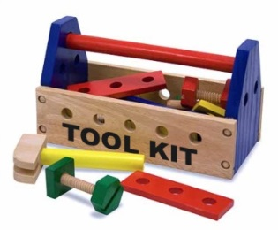
Course Goals
Rough Guide to Facilitation/Debriefing
  Adult Learning Theory Behind Simulation debriefing
  Introduce our Bespoke Blended Debriefing Tool
  Introduce the Basic Debriefing Toolkit

Slide 6


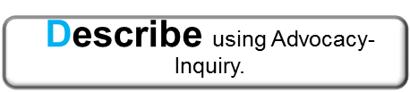



Gosh Unified Debriefing Tool
Prebrief huddle Facilitator/s clarify issues for feedback (Good and bad)
I
“How did that feel?”
Diffuse feelings that may
prevent learning
GU
Gather Up issues from
Participants
Add to your Facilitator list
Use Timeline or +/Δ if not
forthcoming
Select an Issue and apply an appropriate strategy
I D
or
E
Next Issue
Out of Time?
S
Summarise the learning points

Slide 7


Course Goals
Practice makes Perfect
  Advocacy Inquiry workshop
  Simulated Scenarios

Slide 8

Course Goals
  Introduce the Advanced Debriefing Strategy Toolkit

Slide 9


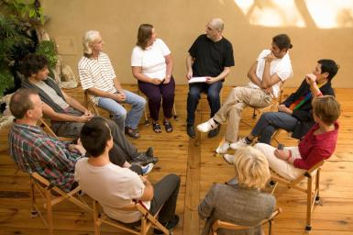
Teacher/Instructor/Facilitator
Rough Guide to Facilitation/Debriefing
The Rapid Assessor
“You did that well”
“You did that wrong”
The Teacher
“Here are some
Solutions or
relevant
Knowledge”
The Facilitator
“What was on you mind?”
(discover your solutions)

Slide 10
Teacher/Instructor/Facilitator
Rough Guide to Facilitation/Debriefing
Competency Sign off
Knowledge based
Simulation
The Rapid Assessor
“You did that well”
“You did that wrong”
The Teacher
“Here are some
Solutions or
relevant
Knowledge”
The Facilitator
“What was on you mind?”
(discover your solutions)

Slide 11

Any Questions?

